Slide 1



Digital Music Store Analysis

Slide 2


Objective
The objective of this project is to leverage SQL to analyze a comprehensive music dataset from a streaming service. By querying and managing the data. The goal is to extract valuable insights into music consumption patterns, identify popular genres, artists, tracks and understand user preferences. The project aims to visualize key trends and provide data-driven recommendations to enhance music services and user experiences.

Slide 3

Methodology used in the data analysis
The methodology for this music data analysis project involves several key steps. Initially, data was imported into a PostgreSQL database and cleaned to ensure accuracy and consistency. SQL queries were then utilized to explore the dataset. Extracting relevant metrics such as play counts, user demographics and track metadata. Aggregate functions joins and subqueries were employed to identify patterns and trends. Visualization tools like tableau or Excel were used to present the findings, highlighting key insights and supporting the development of data-driven recommendations.

Slide 4

Overview of current trends
The current trends in the music industry, as revealed by our analysis, indicate a growing preference for streaming services. With significant increases in daily active users and play counts. Pop and hip-hop genres dominate the charts, while emerging genres like indie and electronic are gaining popularity. Users show a strong inclination towards curated playlists and algorithm-generated recommendations. Additionally, there is a notable rise in the consumption of international music, reflecting a more globalized music taste among listeners. These trends highlights the evolving landscape of music consumption and

Slide 5
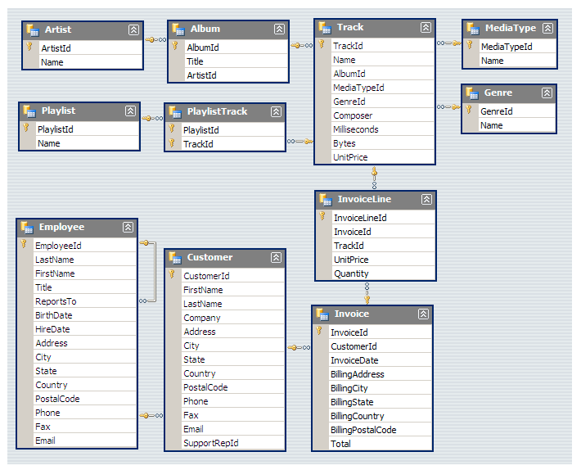
Schema of the project

Slide 6

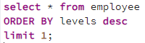

Q1: Who is the senior most employee based on job title?

Slide 7
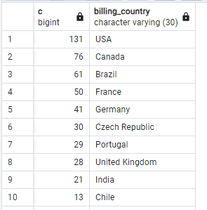
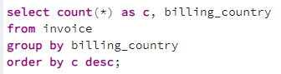
Q2: Which countries have the most invoices?

Slide 8
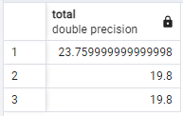
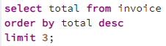
Q3: What are top 3 values of total invoice?

Slide 9
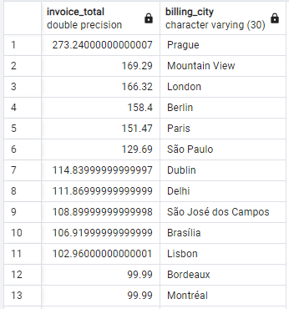
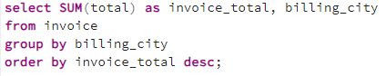
Q4: Which city has the best customers? We would like to throw a promotional Music Festival in the city we made the most money. Write a query that returns one city that has the highest sum of invoice totals. Return both the city name & sum of all invoice totals.

Slide 10
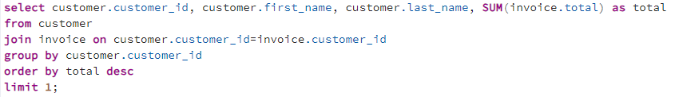
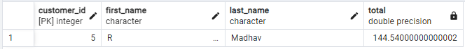
Q5: Who is the best customer? The customer who has spent the most money will be declared the best customer. write a query that returns the person who has spent the most money.

Slide 11
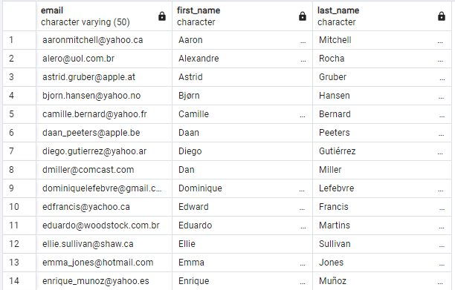
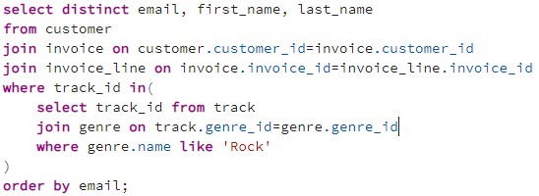
Q6: Write query to return the e-mail, first name, last name and genre of all rock music listeners. Return your list ordered alphabetically by email starting with A.

Slide 12
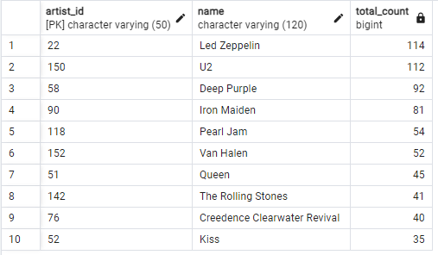
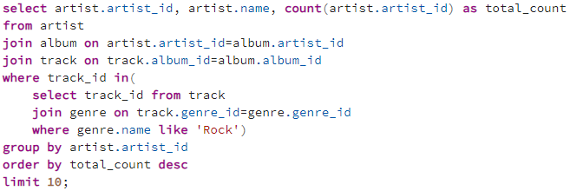
Q7: Lets invite the artists who have written the most rock music in our dataset.
Write a query that returns the artist name and total track count of the top 10 rock bands.

Slide 13
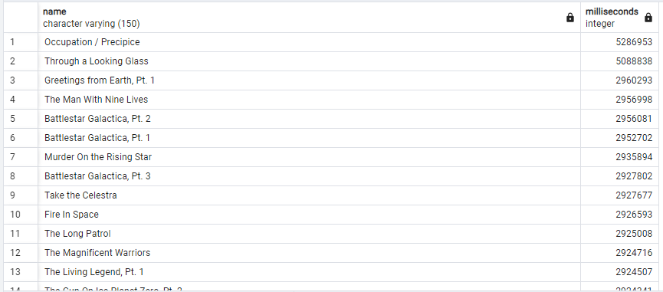
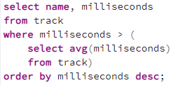
Q8: Return all the track names that have a song length longer than the average song length. Return name and milliseconds for each track. Order by the song length with the longest songs listed first.

Slide 14
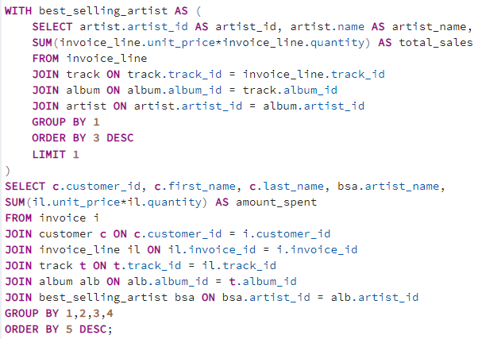
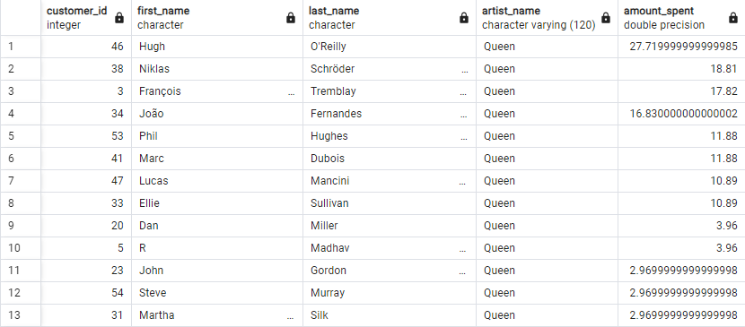
Q9: Find how much amount spent by each customer on artists? Write a query to return customer name, artist name and total spent.

Slide 15
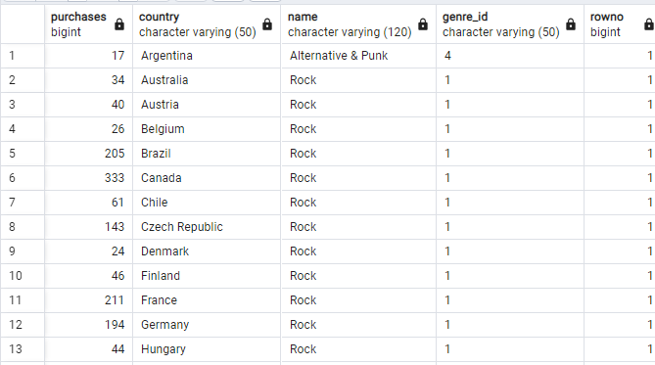
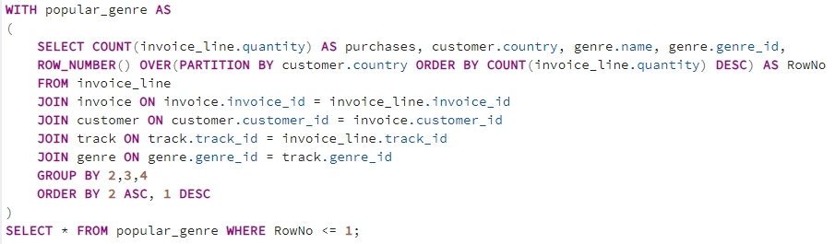
Q10: We want to find out the most popular music genre for each country.
We determine the most popular genre as the genre with the highest amount of purchases. Write a query that returns each country along with the top Genre. For countries where the maximum number of purchases is shared return all genres.

Slide 16
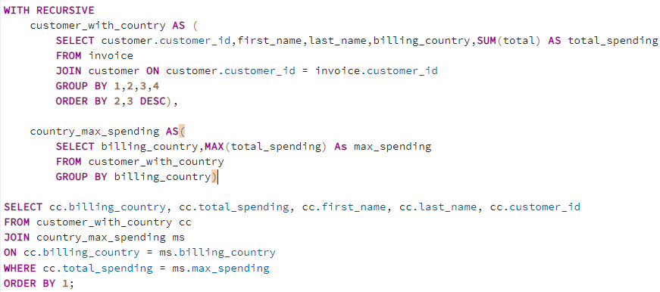
Q11: Write a query that determines the customer that has spent the most on music for each country. Write a query that returns the country along with the top customer and how much they spent. For countries where the top amount spent is shared, provide all customers who spent this amount.

Slide 17
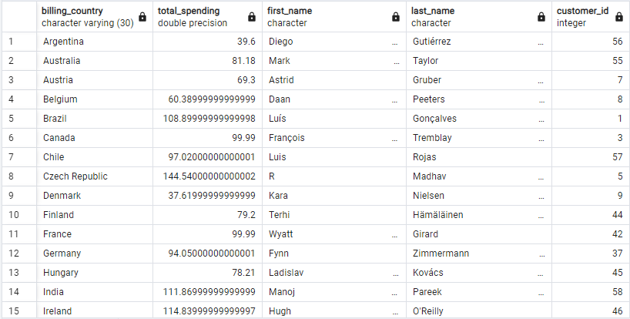

Slide 18

Thank you very much!

